Slide 1
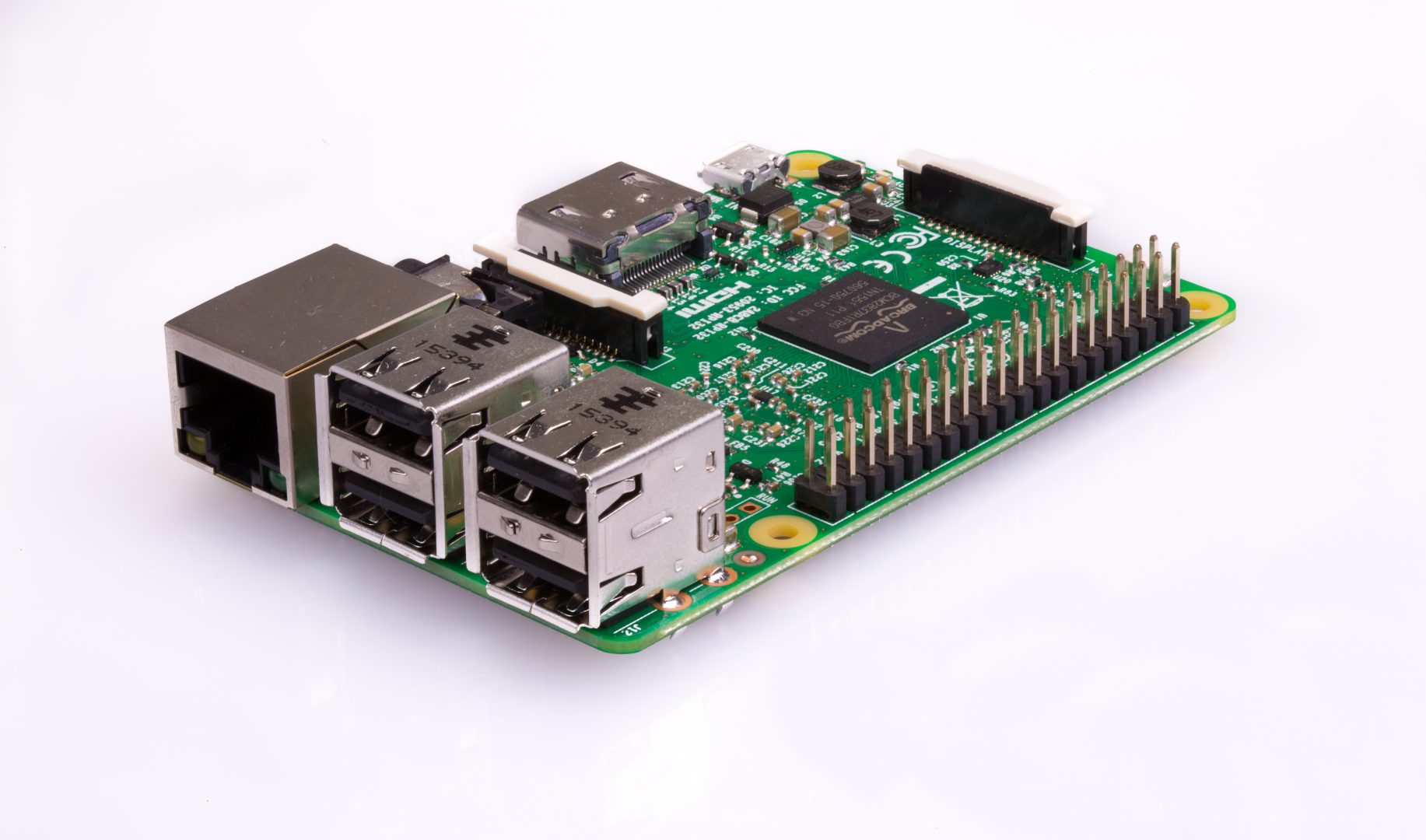
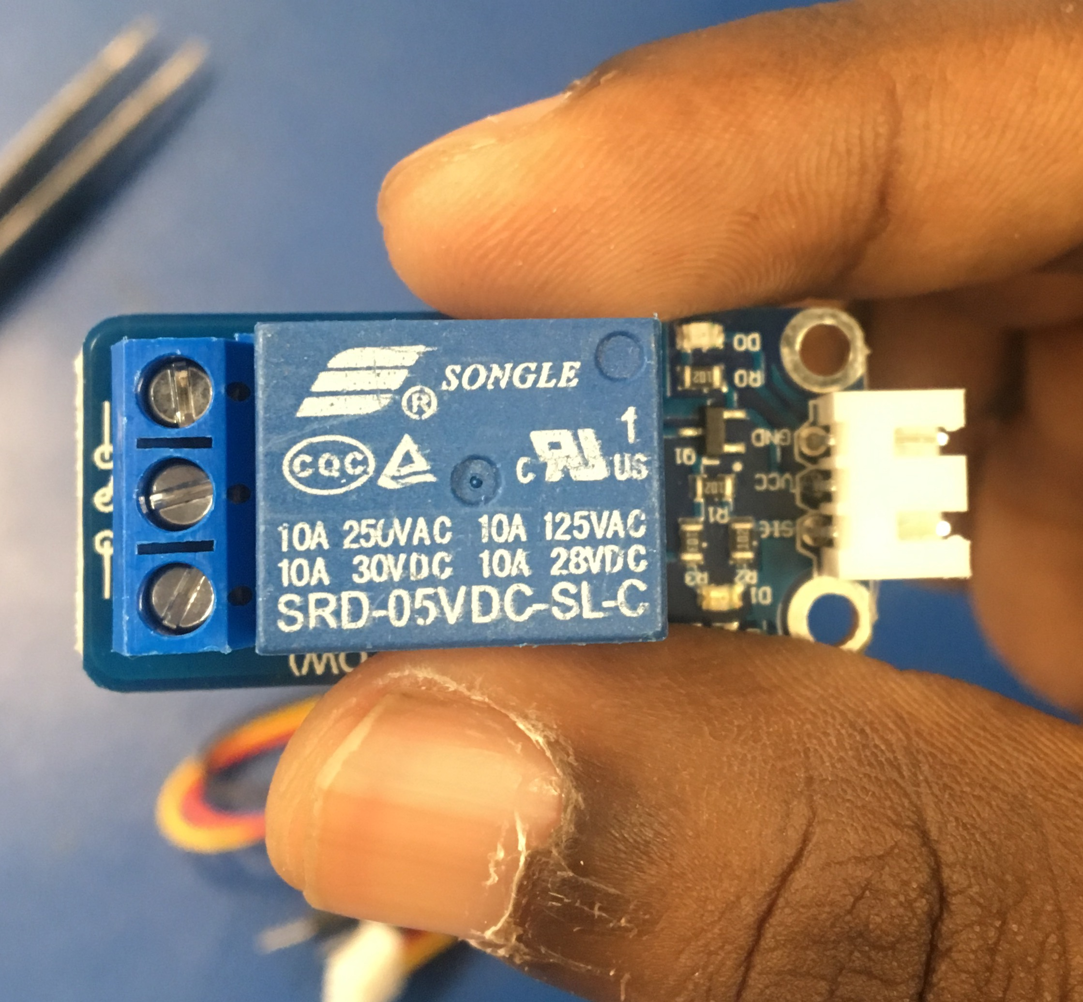
E-Money Transfer
By: Vinokkumar Uthayakumar

Slide 2
Proposal
My project to bring use of QR code money transfer and QR code money pay. I am using a relay module as my sensor to fulfill the security requirements. The relay module will deduct if the payment has done or not with barcode created by my app from android.

Slide 3
Budget
Original Budget: I bought relay module for $8 Buzzer for $6, raspberry pi3 for $112 Total = $126

Slide 4
Schedule
I was able to completed everything according to my schedule

Slide 5
Build Video
Demo Video
https://www.youtube.com/watch?v=TRQ0XKUBW98

Slide 6
Course knowledge
CENG 215 Digital And Interfacing Systems: Circuit construction
CENG 216 Intro to Software Engineering: Rapid application development and Gantt charts
CENG 252 Embedded Systems: Micro-computing knowledge

